Slide 1
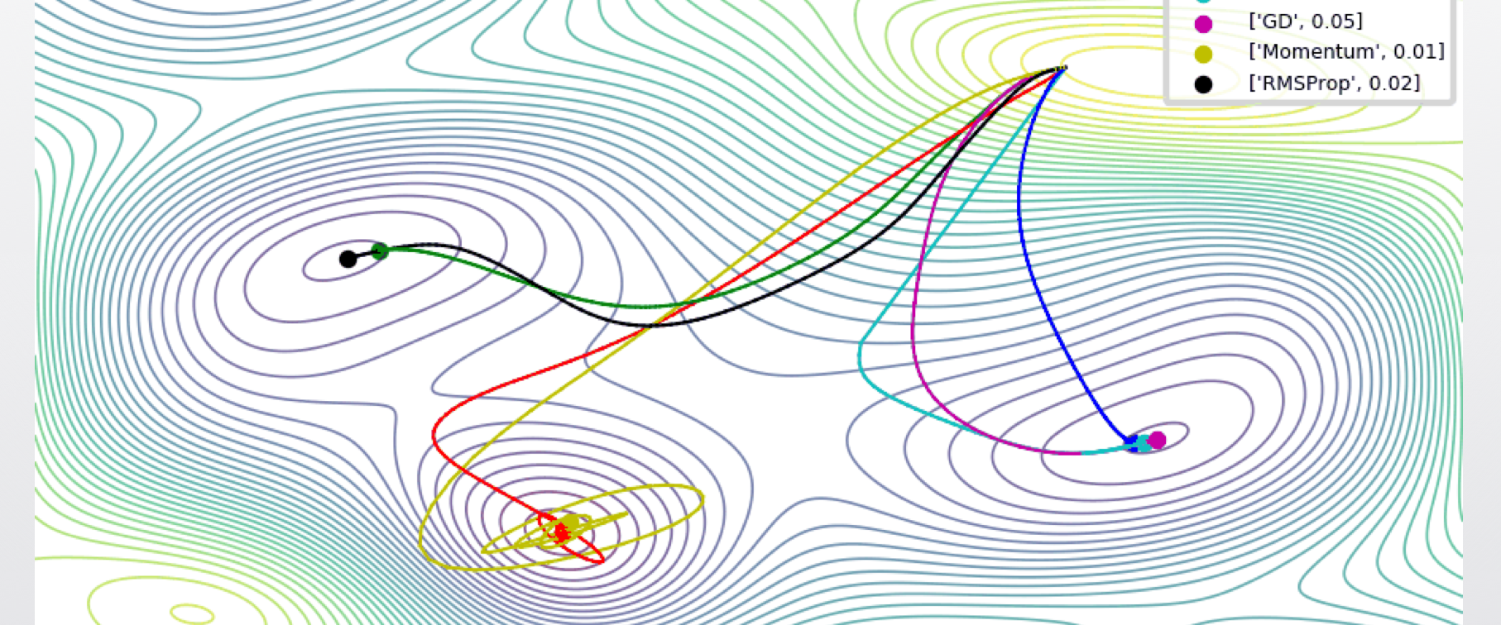
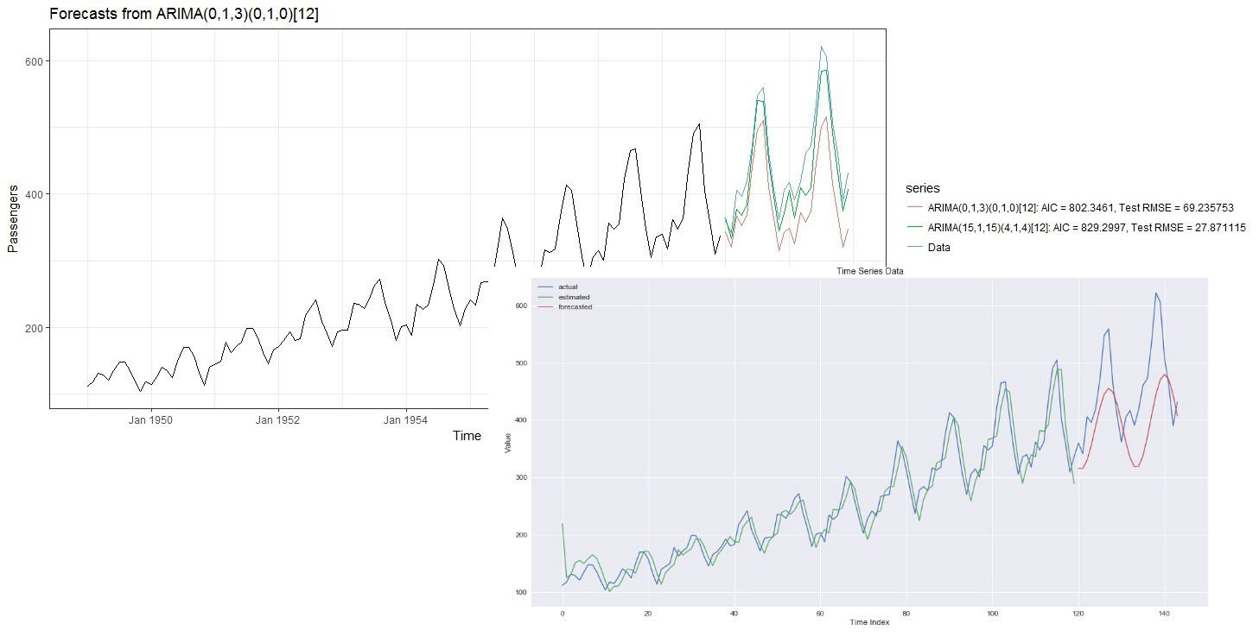
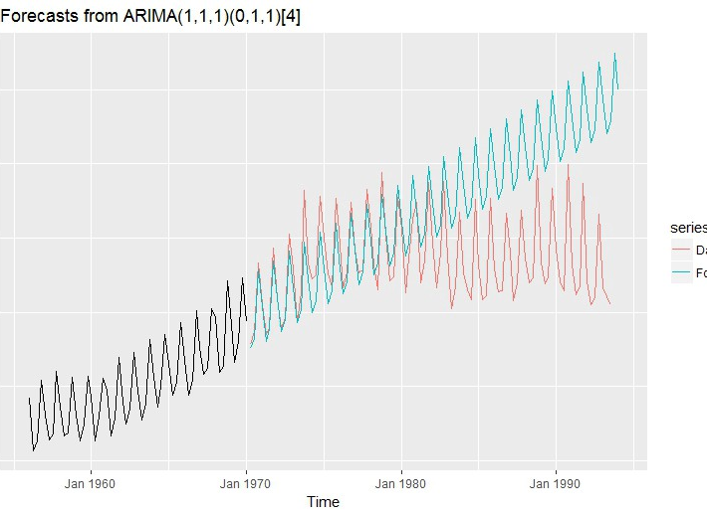
Neural Networks for Demand Forecasting: A Twisted Journey
Skander Hannachi – 05/20/2019

Slide 2
Presentation Outline
Introduction
How it started
ARIMA
RNN and LSTM: not so good results
Facebook Prophet: Surprisingly good results
Disconfirming the disconfirmation: A second look at RNN and LSTM
A deeper dive into LSTM.
Outcomes
Open questions
Q & A

Slide 3

Skander Hannachi
Current Role:
Part of Merchandise Forecasting and Replenishment Technology team at Nordstrom.
Previously:
Consulting and development work for forecasting, replenishment and planning solutions for different North American retailers.
Ph. D in computational intelligence from Tokyo Institute of Technology
Thesis: “A fuzzy logic approach to the emulation of quantum and parallel computing.”
Past research interests included:
Fuzzy Logic
Quantum Computing
Neural Networks
Statistical and ML algorithms applied to marine biology

Slide 4
How it started
Current popular models:
Exponential Smoothing methods (Simple, Holt, Holt-Winters, Croston’s,…) (i.e. glorified moving averages)
On-prem ERP solutions
Ask:
Why are we not using ARIMA?
Can we use Deep Learning and open source?
Is there any value to using RNN and LSTM?

Slide 5
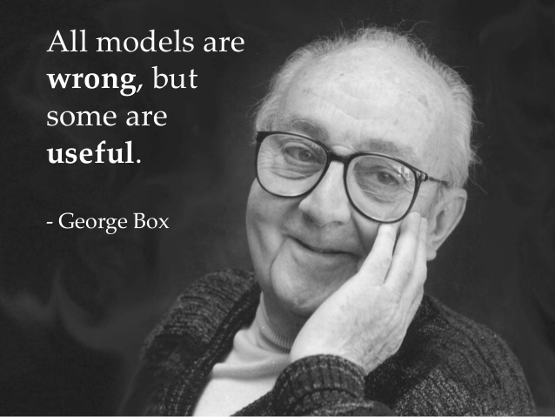
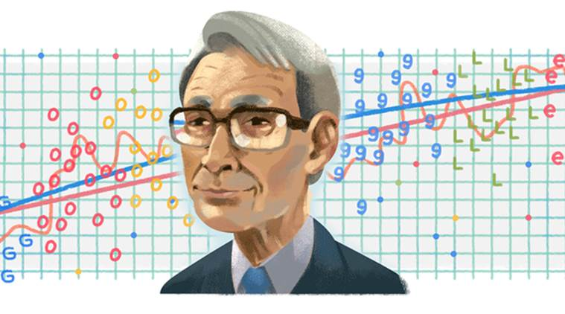
ARIMA experiments:
Auto-Regressive Integrated Moving Average
Box & Jenkins 1970.
The “text book” forecasting method
More sophisticated than exponential smoothing
Popular among econometrics and stats crowd
Easy to automate (AIC, AICc, BIC, …)
Hirotsugu
Akaike

Slide 6
ARIMA experiments:
Didn’t work well with my team’s data
Most time series were 2 years or shorter:
ARIMA needed 3 ~ 4 years (if seasonal differencing is going to work)
Many of the standard ARIMA models are equivalent to an ES model:
Limited or no added value small compared to additional complexity involved
Still valuable: engaging with ARIMA concepts helped team members grasp several key time series concepts

Slide 7


RNN and LSTM experiments:
Can neural networks and deep learning help us?
Can we use open source (…cough, Tensorflow, cough…)?

Slide 8
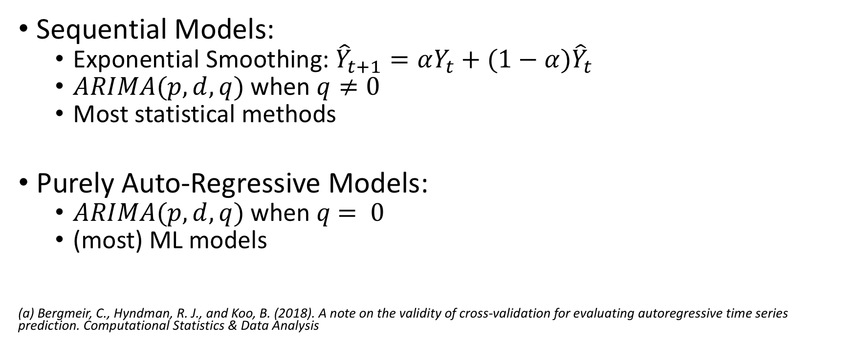
Interlude: Sequential vs. “Purely” Auto-Regressive Models^{(a)}
Sequential Models:
Exponential Smoothing: ${\hat{Y}}_{t+1}=αY_{t}+(1−α){\hat{Y}}_{t}$
$ARIMA(p,d,q)$ when $q≠0$
Most statistical methods
Purely Auto-Regressive Models:
$ARIMA(p,d,q)$ when $q$ $= 0$
(most) ML models
(a) Bergmeir, C., Hyndman, R. J., and Koo, B. (2018). A note on the validity of cross-validation for evaluating autoregressive time series prediction. Computational Statistics & Data Analysis

Slide 9
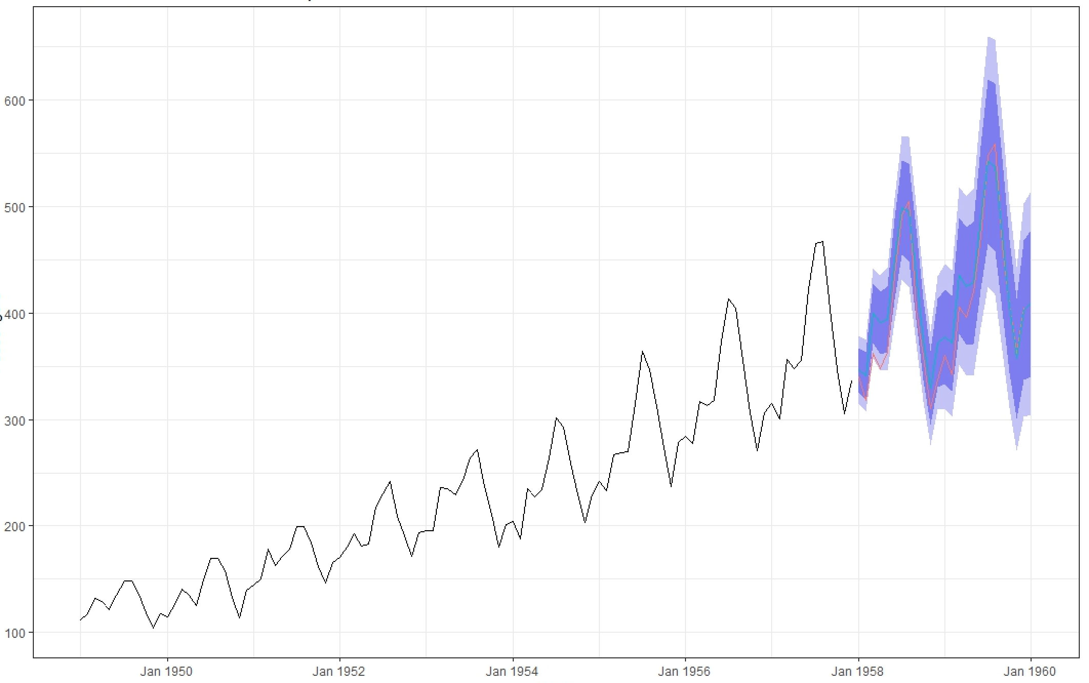
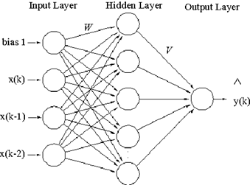
Neural Networks for time series forecasting:
Sequential Model
548 | 559 | 463 | 407 | 362 | 405 | 417 | 391 | 419 | 461 | 472 | 535 | 622 | 606 | 508 | 461
Historical data
Forecasts
Training
Evaluation
Supervised Learning
/Purely Auto-Regressive model
548 | 559 | 463 | 407 | 362
559 | 463 | 407 | 362 | 405
463 | 407 | 362 | 405 | 417
417 | 391 | 419 | 461 | 472
391 | 419 | 461 | 472 | 535
472 | 535 | 622 | 606 | 508

Slide 10
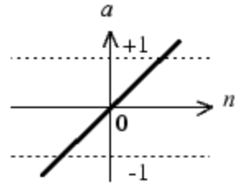
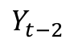
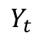
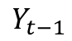
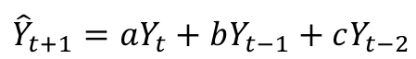
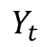
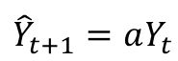
Feed Forward Neural Networks
$$Y_{t}$$
$${\hat{Y}}_{t+1}=aY_{t}$$
$$Y_{t}$$
$${\hat{Y}}_{t+1}=aY_{t}+bY_{t−1}+cY_{t−2}$$
$$Y_{t−1}$$
$$Y_{t−2}$$

Slide 11
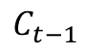
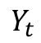
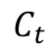
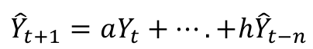
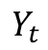
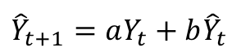
Recurrent Neural Networks and LSTM
Short Term Memory
$$Y_{t}$$
$${\hat{Y}}_{t+1}=aY_{t}+b{\hat{Y}}_{t}$$
$$Y_{t}$$
LSTM
$${\hat{Y}}_{t+1}=aY_{t}+….+h{\hat{Y}}_{t−n}$$
$$C_{t}$$
$$C_{t−1}$$
Long Term Memory

Slide 12
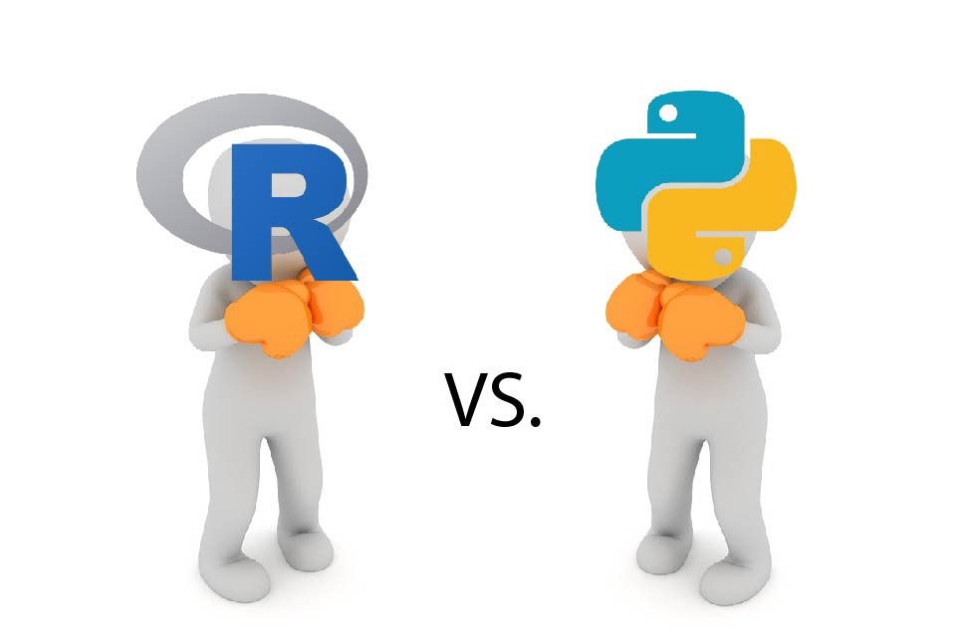
NNet experiments – R:
NNETAR (part of Forecast package from Hyndman)
NNFOR (Kourentzes)^{(a)}
Both use FFN
But we want RNN!!!
Just use Python already!!!!
(a) Kourentzes, N., Barrow, D. K. and Crone, S. F. (2014), ‘Neural network ensemble operators for time series forecasting’, Expert Systems with Applications 41(9), 4235–4244.

Slide 13


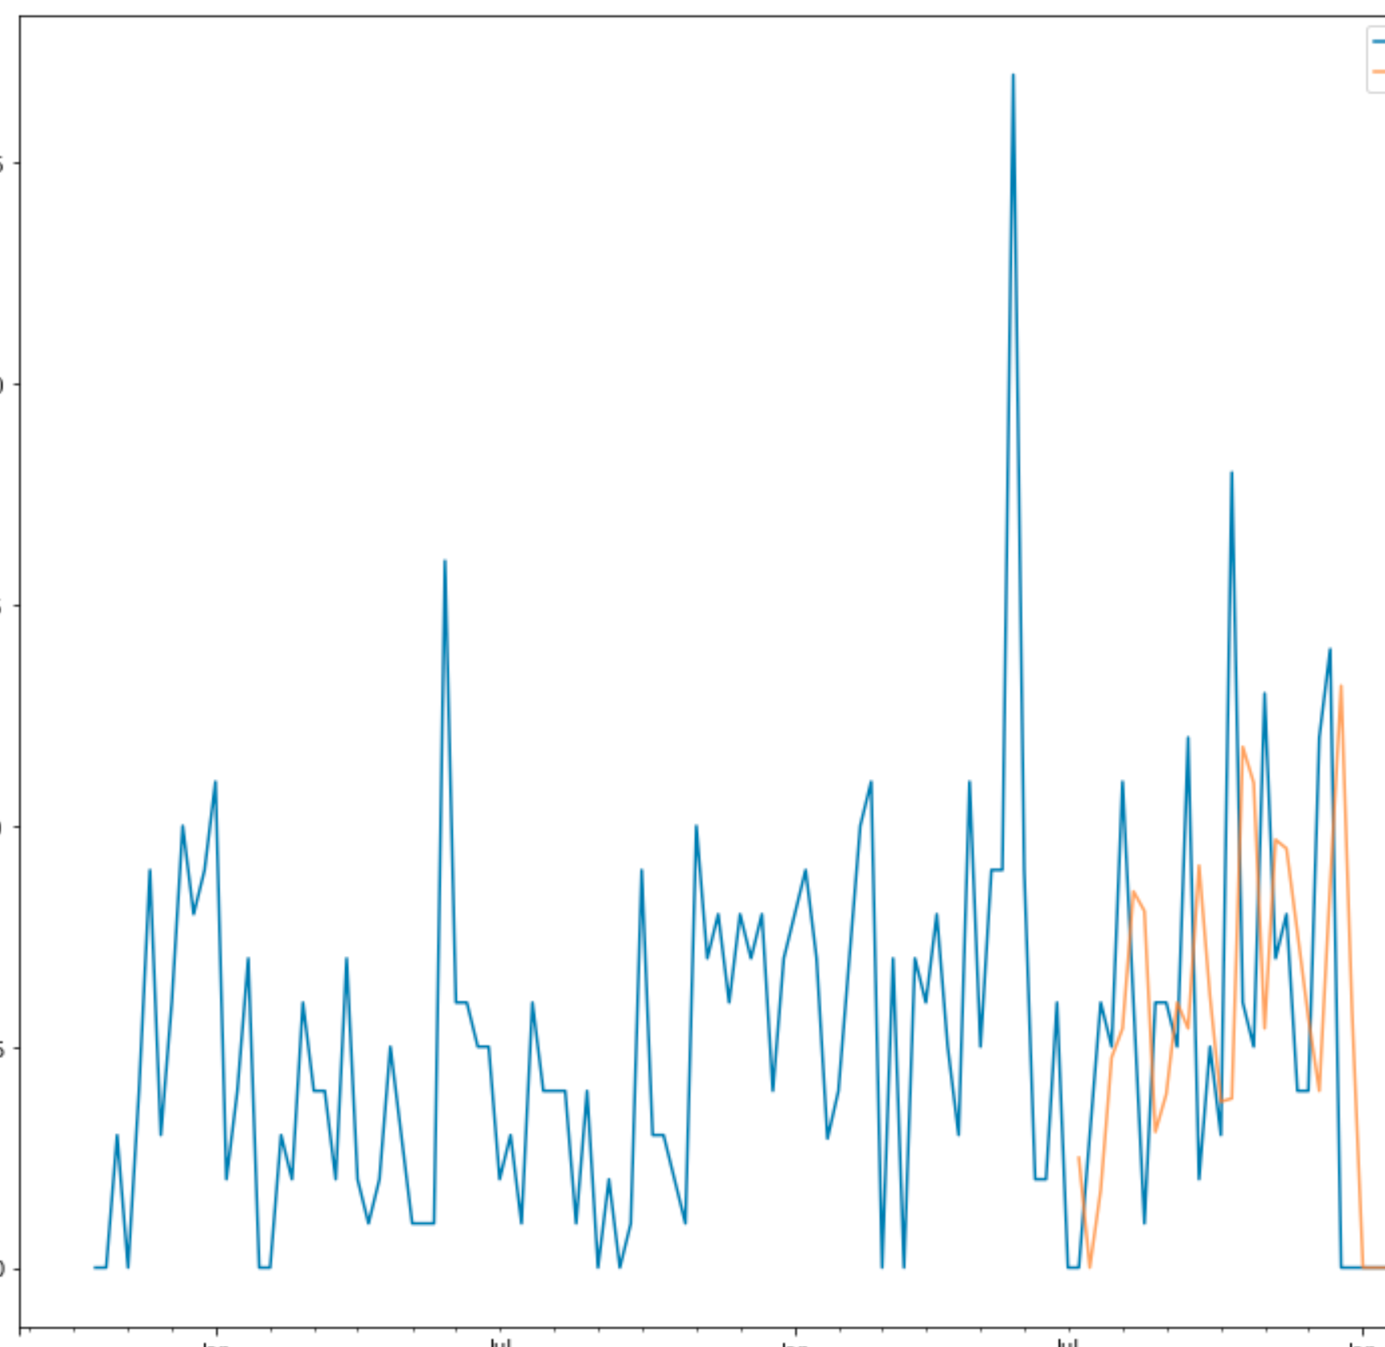
NNet experiments – Python:
Tensorflow:
Using Keras:
Very difficult to train
Forecast uncertainty is not available (has to be simulated)
Using Tf.contrib.timeseries
Easier to use
Forecast uncertainty available
Dude ”Your fancy LSTM is just a random walk”!!!

Slide 14
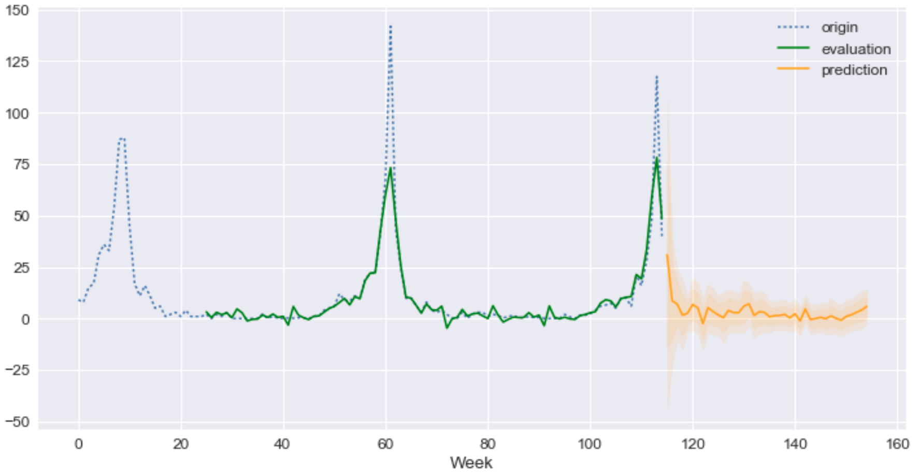
NNet experiments :
Poor results using Keras
Using Tf.contrib.timeseries:
“OK” results
Not better than ES
Automation is not straight forward (compare to AIC and BIC):
No longer a classical model selection problem
Now an AutoML problem: how does it work for time series data?

Slide 15
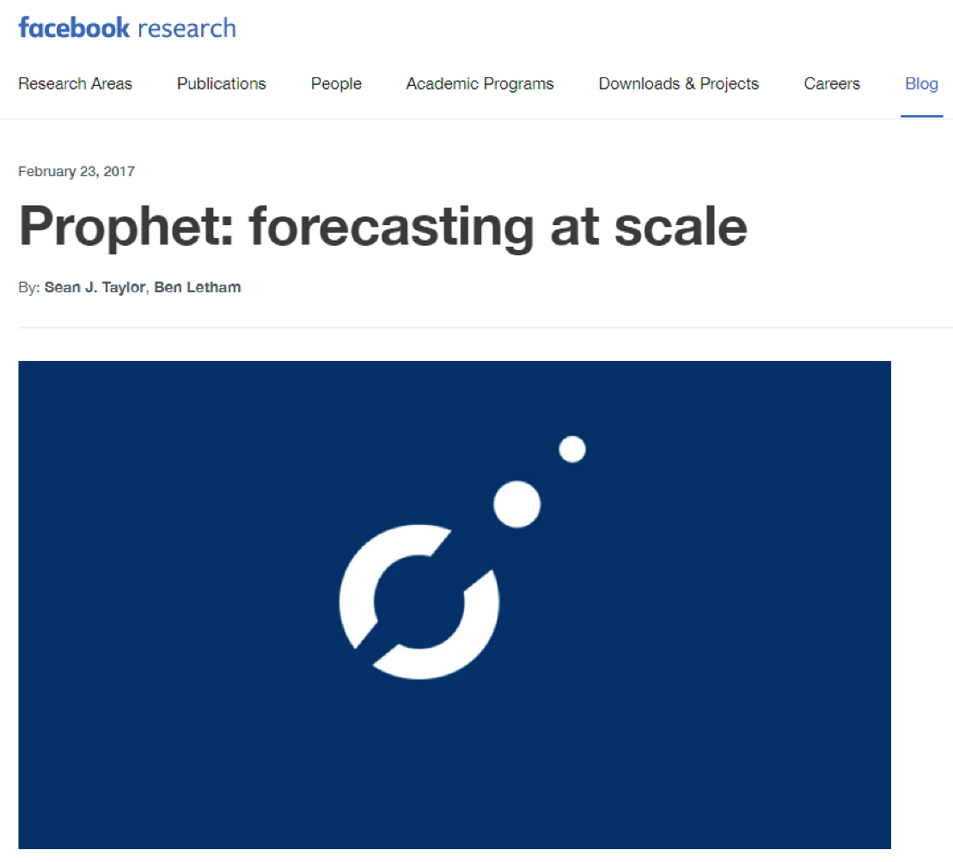
Facebook Prophet: A New Hope
GAM style model:
y(t) = g(t) + s(t) + h(t) + ε(t)
g(t): the trend function (linear or logistic)
s(t): Fourier series for seasonal component
h(t): holidays which occur on potentially irregular schedules over one or more days.
ε(t): normally distributed error term
Under the hood: MAP approximation, MCMC sampling for prediction intervals

Slide 16
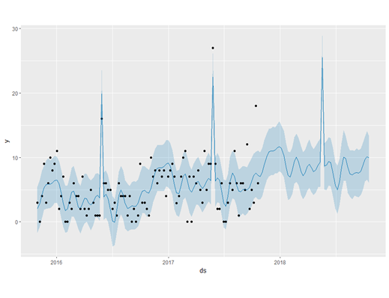
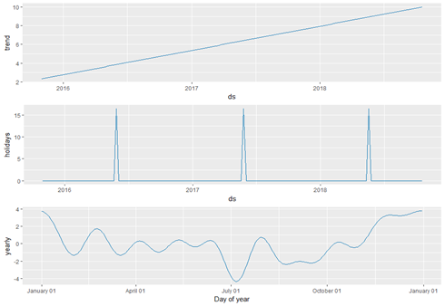
Facebook Prophet: A New Hope
Prophet performed comparably to or better than Simple ES and Holt-Winters
Was “business friendly”
Could it be included in a hierarchical framework?
Questions remained about ease of deployment to production:
Had to be fiddled with to get good results
At the time, would occasionally produce negative forecasts (Has since been fixed in more recent releases)

Slide 17
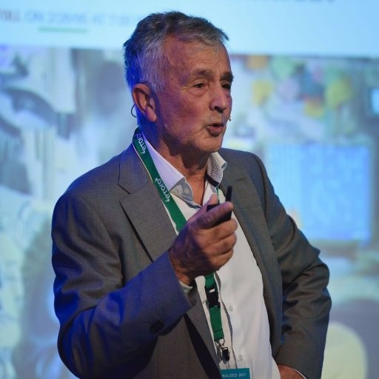
Preliminary Conclusions
ARIMA doesn’t work well
NNets don’t work well
Academic forecasting community agrees^{(a)}
Facebook Prophet: a better solution for our business
Invest into productionizing FB Prophet
…but wait!!!
Now I am become Makridakis,
Destroyer of Neural Networks!!!!!
(a) Makridakis S, Spiliotis E, Assimakopoulos V (2018) Statistical and Machine Learning forecasting methods: Concerns and ways forward. PLoS ONE 13(3):e0194889. doi:10.1371/journal.pone.0194889

Slide 18
Disconfirming the disconfirmation
DeepAR
MQ-RNN
Uber’s LSTM models
Kaggle forecasting competitions 1st place submissions using LSTM (or ensembles that include LSTM)
Must rethink our conclusions about NNets!

Slide 19

One does not simply
Use vanilla LSTM on a univariate time series

Slide 20
Vanilla LSTM vs. Encoder-Decoder architectures:
Vanilla LSTM: Same structure as a feed forward network with fancier hidden layers
LSTM
LSTM
LSTM
LSTM
LSTM
LSTM
LSTM

Slide 21
Vanilla LSTM vs. Encoder-Decoder architectures:
seq2seq models:
Predictions
Embedding
Encoder
LSTM Layer
LSTM Layer
Decoder
LSTM Layer
LSTM Layer
Embedding
New Data
Training data

Slide 22
Vanilla LSTM vs. Encoder-Decoder architectures:
seq2seq Embeddings vs. State Space representations:
Predictions
Predictions
Non Linear/Non Gaussian
Decoder
Reverse Transform
Observation Equation
Linear/Gaussian
Embedding
State/Phase Space
State Equation
Non-Parametric
Parametric
Encoder
Transform Time series
Structural assumptions
Training data
Training data

Slide 23

Stats methods vs. DL methods
The sales pitch (local model vs. global model):
Stats methods:
Univariate
Can’t handle meta-data (categorical variables) and covariates
Don’t benefit from similarities across time series
DL methods:
Multivariate
Leverage meta-data (categorical variables) and covariates
Can learn from similarities across different time series
This is an oversimplification!!!!

Slide 24
Stats methods vs. DL methods
Some more nuance:
Stats methods:
Can be “globalized”
Multivariate: VAR models, Hierarchical forecasting
Can handle covariates: SARIMAX, BSTS, Prophet,…
Can learn from similarities across different time series: VAR, Hierarchical forecasting
Can leverage meta-data (categorical variables): Hierarchical forecasting
What is the real advantage then ??

Slide 25
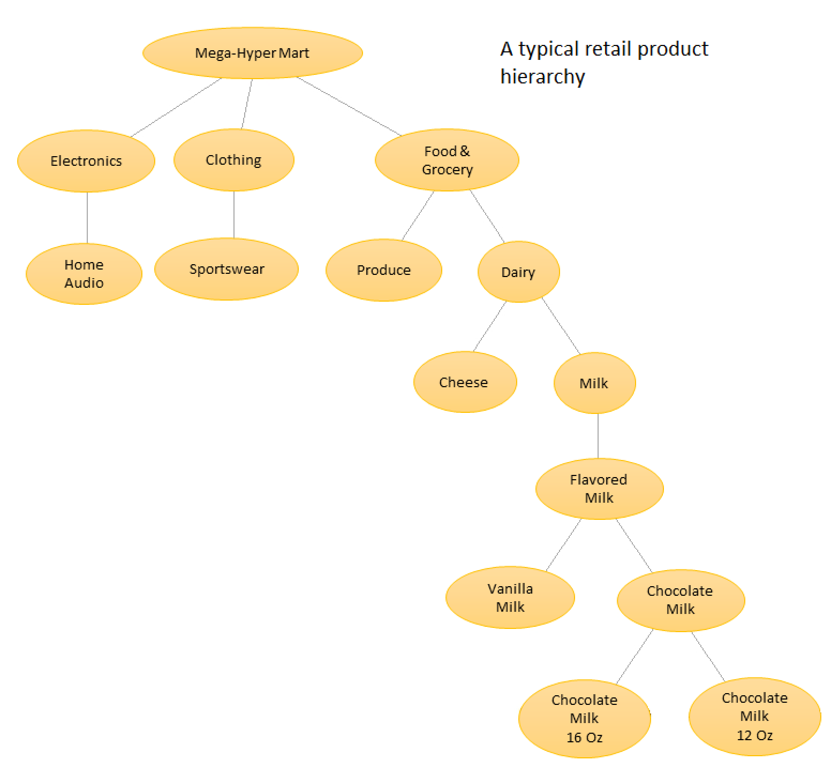
Hierarchical forecasting:
Fixed hierarchy: Which time series are correlated is determined before hand and is static
Is it really global? Yeah, but….

Slide 26
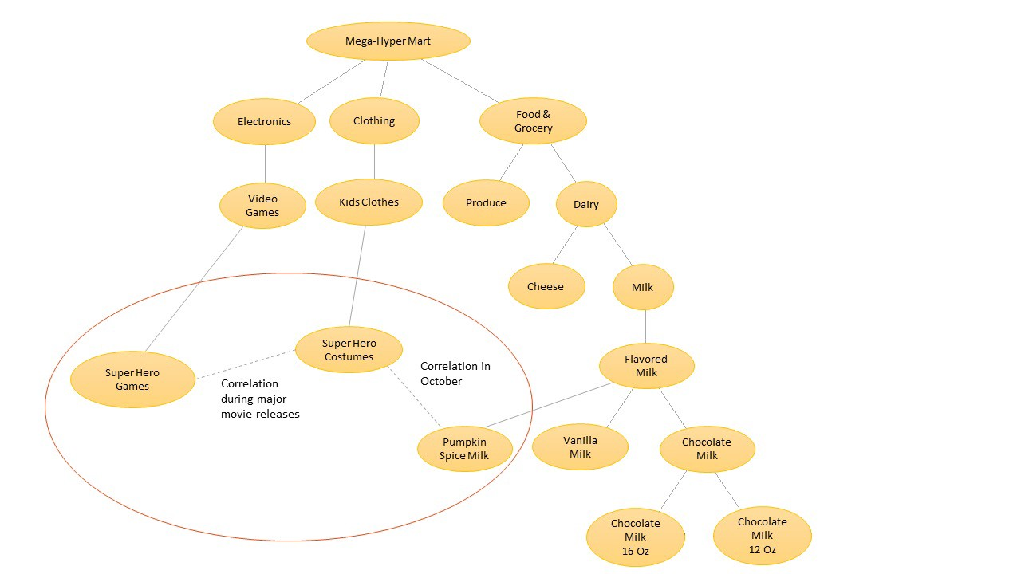
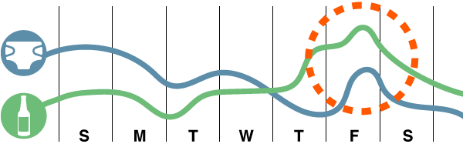
DL models: Dynamic hierarchical forecasting
Dynamic hierarchy/product groupings:
Which time series are correlated is learned from the data.
Can change over time
Time series that weren’t part of the original training
Non need for frequent retraining
Unsuspected correlations
LSTM Encoder
Embedding
LSTM Layer

Slide 27
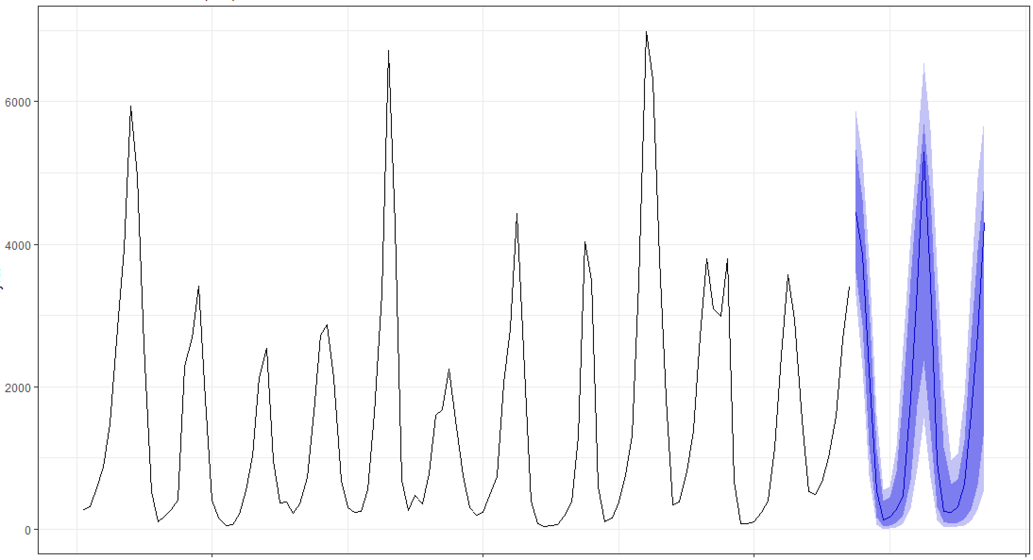
DeepAR^{(a)}
Probabilistic forecast: Output is a parametric distribution
Product grouping agnostic: learns correlations across all products
Likelihood Model
Embedding
Likelihood Model
Probabilistic Forecasts
LSTM Layer
LSTM Layer
LSTM Layer
LSTM Layer
Embedding
New Data
Allows for Cold Starts/New Products
Forecasts in new geos
(a) Flunkert, V., Salinas, D., and Gasthaus, J. (2017) DeepAR: Probabilistic forecasting with autoregressive recurrent networks. http://arxiv. org/abs/1704.04110.

Slide 28
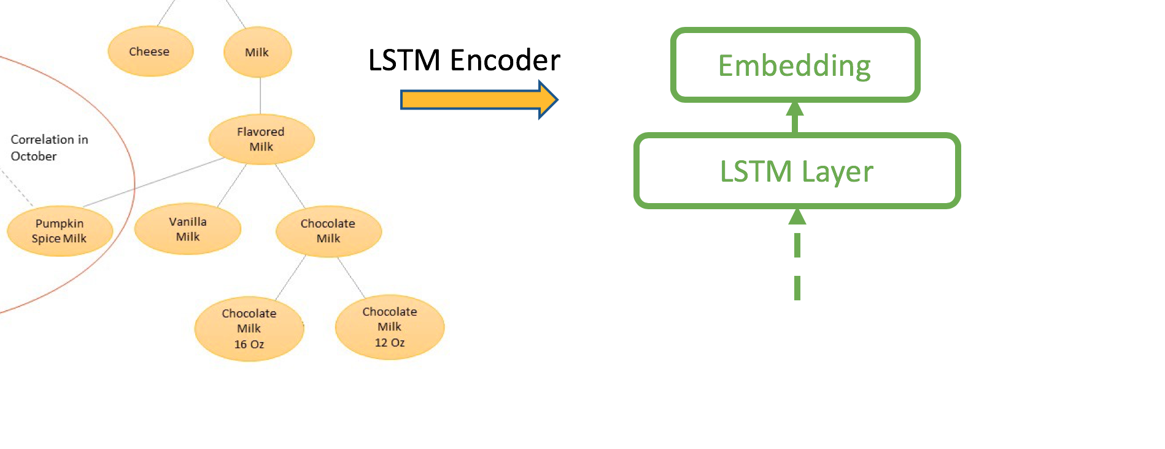
But hierarchies are not always bad….
Model explainability:
Product hierarchy is “dual-intent”:
Grouping of time series for better signal
Business/Org driven grouping
What on earth is an LSTM embedding?
-> Merchandise/Fashion Space à la Zalando^{(a)} instead of State/Phase Space?
Heinz, S., Bracher, C., and Vollgraf, R. (2017) An LSTM- Based Dynamic Customer Model for Fashion Recommendation. arXiv preprint arXiv:1708.07347

Slide 29
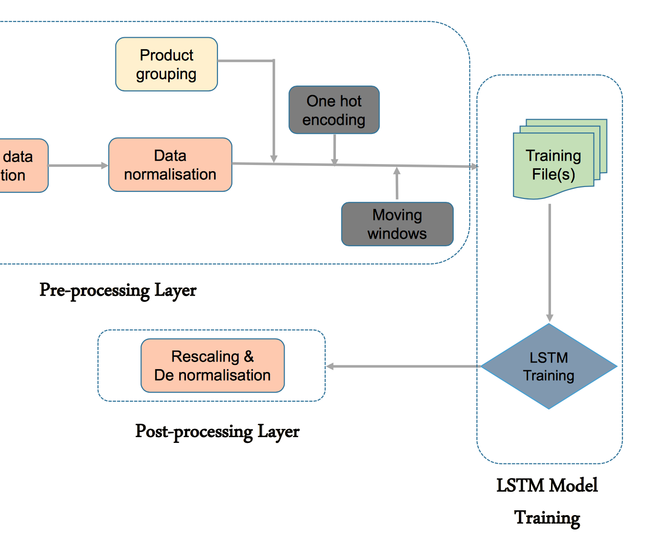
Embeddings and Hierarchies: Best of both worlds…
In (a) and (b): Domain knowledge based product grouping improves forecast accuracy.
In (b): Preprocessing scheme tested at multiple levels of a real E.com product hierarchy (Walmart.com)
Bandara, K., Bergmeir, C.& Smyl, S. (2017) Forecasting Across Time Series Databases Using Recurrent Neural Networks on Groups of Similar Series: A Clustering Approach. http://arxiv.org/abs/1710.03222.
(b) Bandara, K., Shi, P., Bergmeir, C., Hewamalage, H., Tran, Q., and Seaman, B. (2019). Sales demand forecast in e-commerce using a long short-term memory neural network methodology. http://arxiv.org/abs/1901.04028

Slide 30



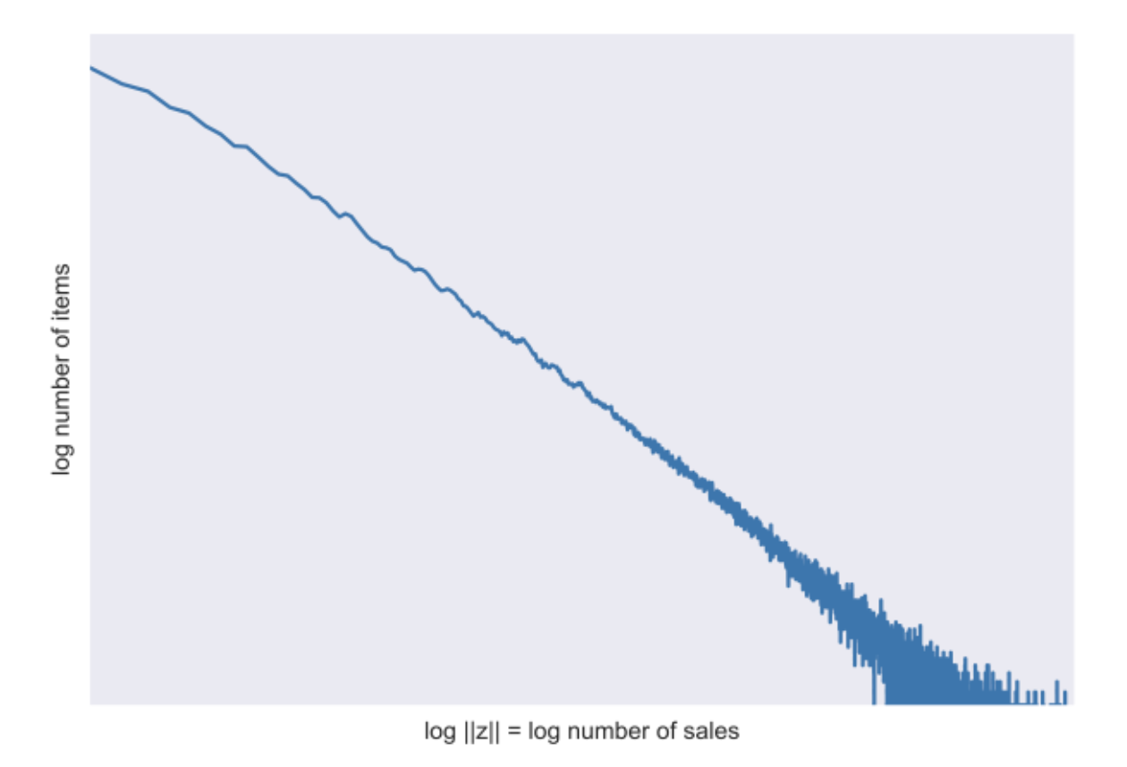
…maybe?
Experiments in (b) don’t use domain based priors
Only empirical metrics (sales rank and sparsity) are used for clustering
Moreover in (c) it is argued that E.com data is scale free => Clustering is impossible
Team
Clustering is possible!!!!
Team
Clustering is not possible!!!!
Bandara, K., Bergmeir, C.& Smyl, S. (2017) Forecasting Across Time Series Databases Using Recurrent Neural Networks on Groups of Similar Series: A Clustering Approach. http://arxiv.org/abs/1710.03222.
(b) Bandara, K., Shi, P., Bergmeir, C., Hewamalage, H., Tran, Q., and Seaman, B. (2019). Sales demand forecast in e-commerce using a long short-term memory neural network methodology. http://arxiv.org/abs/1901.04028
(c) Flunkert, V., Salinas, D., and Gasthaus, J. (2017) DeepAR: Probabilistic forecasting with autoregressive recurrent networks. http://arxiv. org/abs/1704.04110.

Slide 31
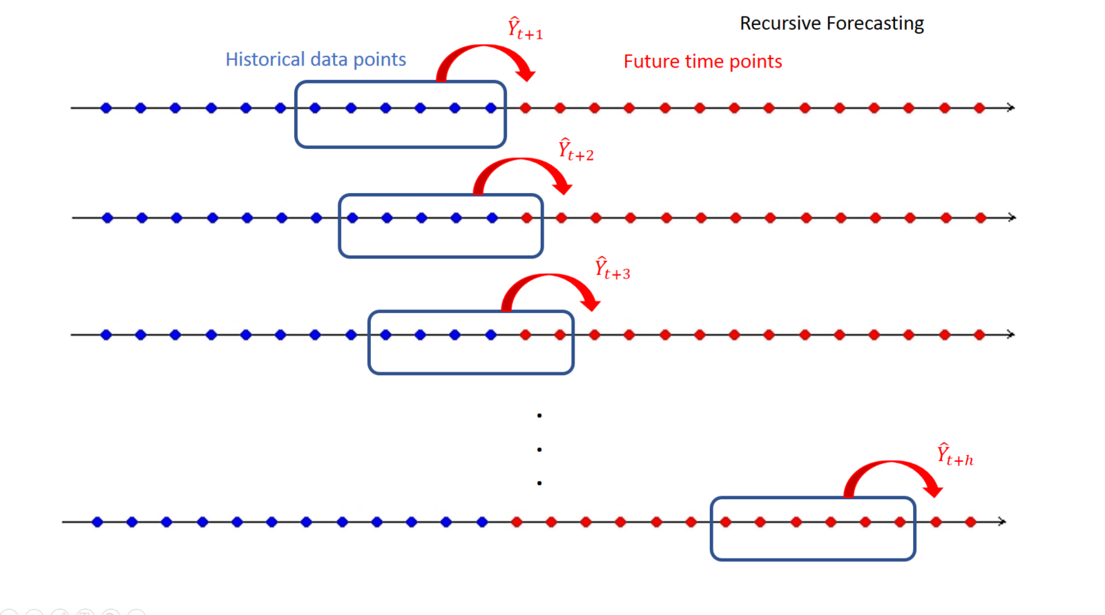
Stats methods: Recursive forecasting
Forecast errors accumulate the further out the forecast horizon

Slide 32
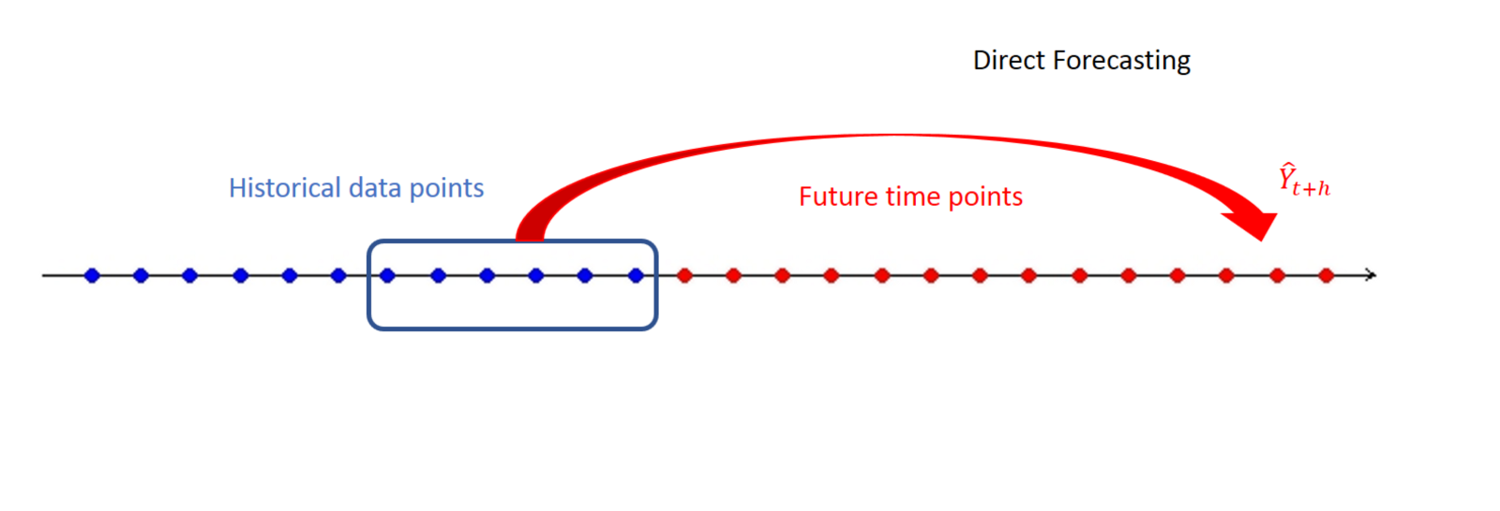
(Some) DL methods: Direct forecasting
Improvement in forecast errors, smaller prediction intervals ^{(a),(b)}
Chevillon, G. (2007), ‘Direct multi-step estimation and forecasting’, Journal of Economic Surveys 21(4), 746–785.
Bontempi, G.; Taieb, S. B.; and Le Borgne, Y.-A. 2013. Machine learning strategies for time series forecasting. In Business Intelligence. Springer. 62–77.

Slide 33
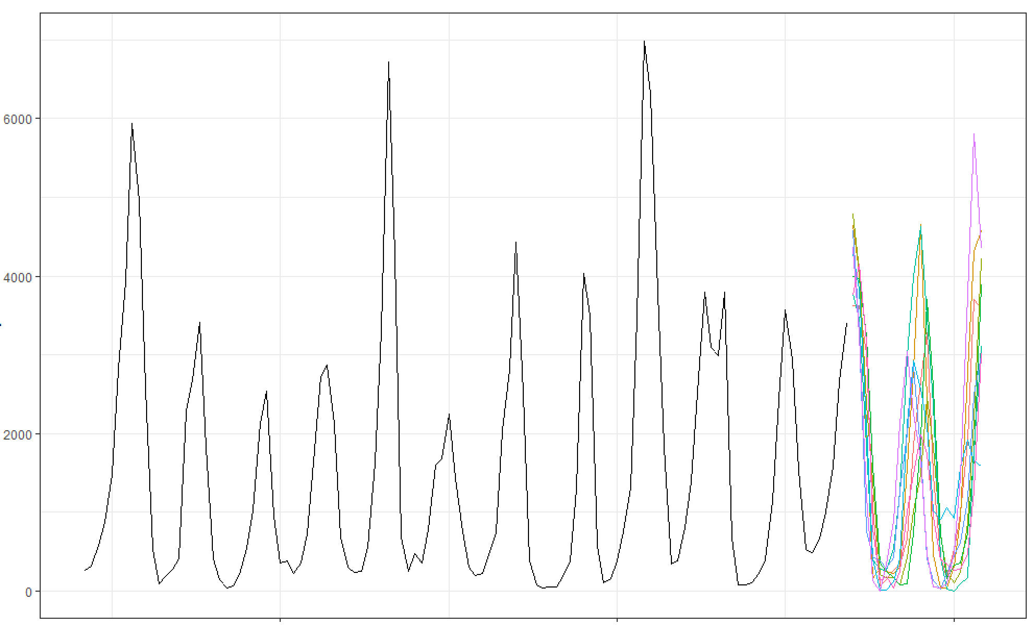
MQ-RNN^{(a)}
Quantile forecast: Output is a non-parametric distribution
Product grouping agnostic: learns correlations across all products
Direct forecasing
Embedding
Quantile Forecasts
LSTM Layer
Local FFN Decoder
Local FFN Decoder
Global FFN Decoder
LSTM Layer
Embedding
New Data
(a) Wen, R., Torkkola, K. , and Narayanaswamy, B., (2017) A multi-horizon quan- tile recurrent forecaster. In NIPS Time Series Workshop.

Slide 34
Additional Models
ES-RNN:
Local Holt-Winters + Global RNN: 1st place in M4 Competition
Spline RNN:
DeepAR: Full distribution, but parametric
MQ-RNN: Non-parametric quantiles, but risk of inconsistent quantiles (e.g. P(85%) > P(90%))
Spline RNN: full distribution, non-parametric: Best of both worlds!!!
Deep State Space Models:
Bridging the gap between SSM and DL
Deep Factor Models:
More comprehensive uncertainty modelling
CNN and Wavenet models:
Bring more frequency domain techniques to the mix
Kaggle
Wikipedia Traffic Forecasting:
seq2seq model
COBO Training
Corporacion Favorita:
Ensemble of 2 Tree based models + 2 NNets

Slide 35
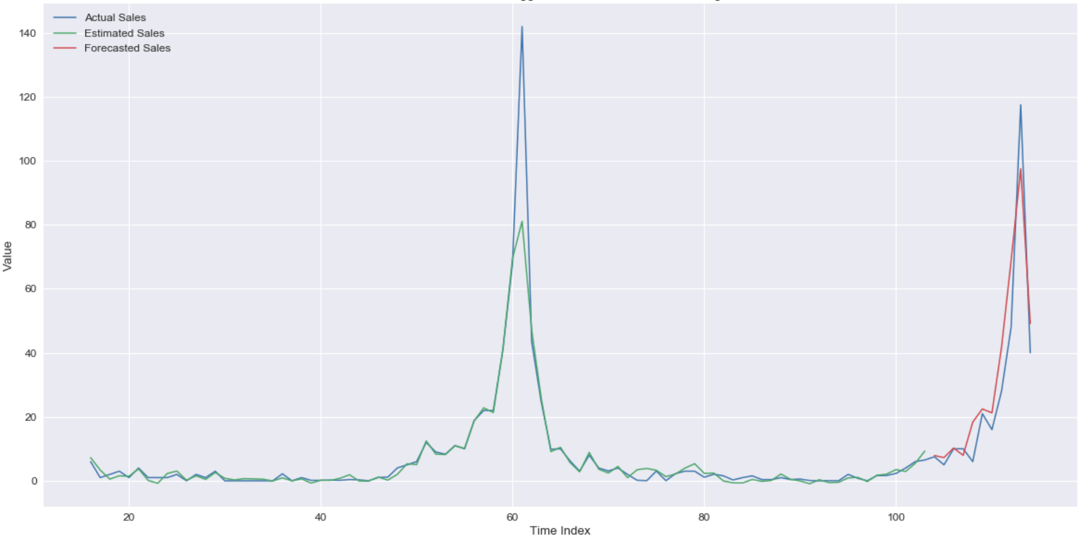

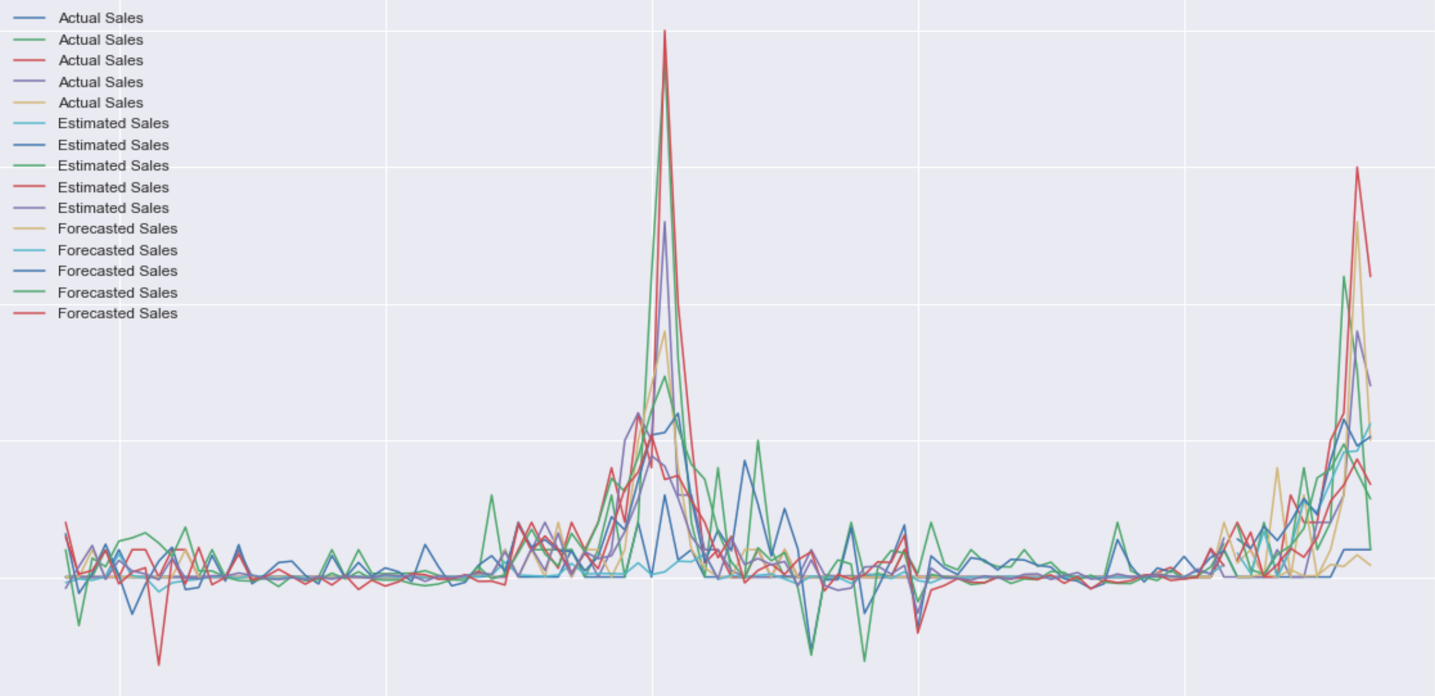
Outcomes
Professional:
DL for time series forecasting worth pursuing,
not just a result of the current ML/DL hype
Personal:
Working with a team at the University of Brasilia:
Supervising a master’s student
LSTM for forecasting grouped time series of medication demand:
Statistical methods outperformed univariate vanilla LSTM
Multivariate seq2seq LSTM outperforms statistical methods
Exploring Bayesian Optimization and TPE for hyper-parameter search

Slide 36
Open questions
When are Neural Networks suitable? And when are they overkill?
Big Data regime: DL = ‘Good’
Small Data regime/univariate: Stats = ‘Good’
Mid level regimes (10s~100s)? Is there a middle ground (e.g trees?)
What about tree based methods:
Shouldn’t they cover a lot of the same territory as Nnets?
In what case will RF, GBT, etc.., work better than LSTM?
RF are easier to train
RF can be trained more frequently

Slide 37
Open questions
Model explainability redux: Buyers, Marketers, Supply Chain Analysts: Can they get the results of a DL model?
ARIMA/FB Prophet/ES are easily explainable.
DL methods: not blackbox, but still opaque
ES-RNN? Deep State Space Models?

Slide 38


Unit Demand Forecasting’s Evil Twin….
Unit Demand Forecasting
for replenishment
Assortment Planning ^{(a)}
Straightforward time series/supervised learning problem
Baselines (ARIMA, ETS)
Actuals / Accuracy intuitive
Clear separation between the forecasting problem and the optimization problem (most of the time)
Combined optimization, forecasting, and clustering problem
Counterfactuals / What-ifs
Substitution effects
Product Hierarchies are essential
(a) See for example: Fisher, M. and Vaidyanathan, R. (2014). A demand estimation procedure for retail assortment optimization with results from implementations. Management Sci. 60(10), 2401–2415.

Slide 39
Recap:
Deep Learning does have something to offer to Demand Forecasting
But tread with caution
Seq2seq models are better than Vanilla LSTM
Dynamic learning of correlations across series
Probabilistic and quantile forecasting
More realistic view of the demand picture
Direct forecasting vs. recursive forecasting
Better for SC purposes
Open questions:
Suitability of DL?
Trees (RF, XGBoost,…) ?
Explainability to non-technical partners
DL + Assortment planning ?
Thank you for your time and consideration.

